Slide 1
Keras
A Deep Learning Library for Theano and Tensorflow

Slide 2
Purpose
Main goal is to allow for fast and easy prototyping of DL architecture
Built on top of (instead of as a toolbox for) popular DL frameworks
Flexible implementation

Slide 3
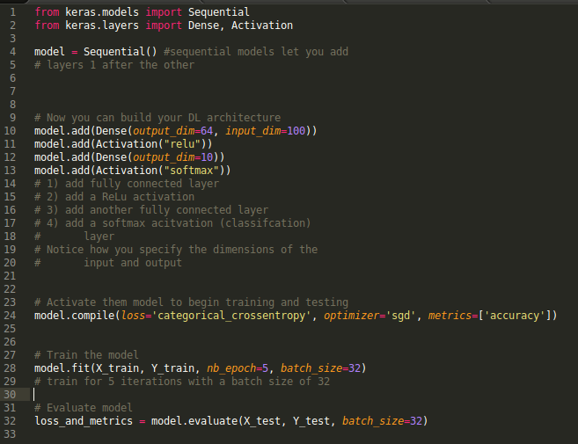
What is unique about Keras?
Keras code is modular and you don’t interact with the backend at all
Easy to use, with support for Python
No performance loss

Slide 4
Use Cases?
Maybe not used in final implementations as it might be less flexible than Tensorflow or Theano
Deep Learning for computational biology
Deep Learning for Population Genetic Inference
DeMo Dashbord: Visualization and Understanding Genomic Sequences Using Deep Neural Networks

Slide 5
More Papers
Recent Deep Learning Papers

